Slide 1

Optimal Circle Search Despite of Faulty Robots
Presented By-Vanshika Kumawat( M22MA207)
Supervisor - Dr. Subhash Bhagat

Slide 2
Introduction
The objective is to Calculate the optimal case time to find the hidden exit by a non-faulty robot in a group that consists of both faulty and non-faulty types of robots.

Slide 3
(n,f,k)-Search Problem on a circle
It deals with the search for a hidden exit point in a network or graph, here searching on a circle.
Where n= no. Of robots , f= no. Of faulty robots ,k=no. Of exits
The goal is to find an algorithm or strategy to locate the exit point despite faulty robots.

Slide 4
Evacuation Problem
Evacuation problem is the measure of completion time with respect to the last finder of the hidden exit.
The circle search model for non-faulty robots was introduced as an evacuation problem and can be analyzed in both the wireless and face-to-face communication models.

Slide 5
Circle search problem as a subcase of Evacuation Problem:
In optimal circle search problem, focused on investigating evacuation of robots in the presence of crash and/or Byzantine faults.
Evacuation is different from search in that it measures the completion of the algorithm by the time it takes the last non-faulty robot to find the exit (i.e., all the robots have to go to the exit).

Slide 6
Faulty Robots in the Model
1.Crash Faulty Robots
Crash-faulty robots are those that stop functioning or crash during the search.
When a robot encounters a crash fault, it becomes unresponsive and no longer participates
in the search process.
This can significantly impact the search time as the remaining robots need to compensate for
the loss of a robot's contribution.

Slide 7
2.Byzantine Faulty Robots
Byzantine faulty robots exhibit more complex behavior.
They may provide incorrect information or behave in unexpected ways.
It can mislead other robots by providing false or misleading information about the location of the hidden exit.
This can lead to confusion and longer search times as the other robots struggle to make accurate decisions based on unreliable data.

Slide 8
Computational Model
Communication
Adversary
Robot Movement
Fault Types

Slide 9
Preliminaries for Robots:​
Dimensionless robots​
Starting at the center of a unit radius disk​
Unknown Exit located on the unit circle​
Maximum speed of 1​
Wireless communication​
Uncorrupted messages with unique identities​
Robots will be searching the unit circle either ​
clockwise (cw) or counter-clockwise (ccw).​
At each time point, all agents know the location of every agent following the protocol.

Slide 10
Two Types of Faulty Robot Models:
Crash Faulty Robots
The worst-case search time occurs when one of the robots crashes during the search process. This results in a total search time of O(n), where n is the number of robots participating in the search.
Byzantine Faulty Robots
The worst-case search time is influenced by the presence of malicious robots that provide incorrect information.
In the (n,1)-search model, the worst case search time is O(n) as well, due to the possibility of multiple faulty robots providing misleading information.

Slide 11
Optimal Search Time Bounds
Discuss the lower and upper bounds for the optimal search
Time.
Worst Case Search Time for (n,f,k)-Search
When considering the worst-case scenarios for (n,f,k)-search,
Analyze the cases of n ≥ f+1 and n≥k for
both crash faulty and byzantine faulty robots.

Slide 12
Successful Search in a Robot Network
A successful search in a robot network occurs when the exit(nearest in case of multiple exits) is found by a non-faulty robot that can visit its location. Additionally, all the remaining non-faulty robots should know the correct location of the exit.

Slide 13

1 Unknown Exit (K=1)
Lower Bound for (n, f)-Search
Lower Bound for (n, f)-Search with Crash-Faulty Robots:
The worst-case search time Sc(n, f) for n ≥ f + 1 robots exactly f of which
are crash-faulty satisfies
Sc(n, f) ≥ 1 + (f + 1)$\frac{\text{2}\text{π}}{n}$
Lower Bound for Byzantine (n, 1)-Search :
The worst-case search time S(n) for n ≥ 2 robots exactly one of which
Is Byzantine-faulty satisfies S(n) ≥ 1 + $\frac{\text{4}\text{π}}{n}$.

Slide 14
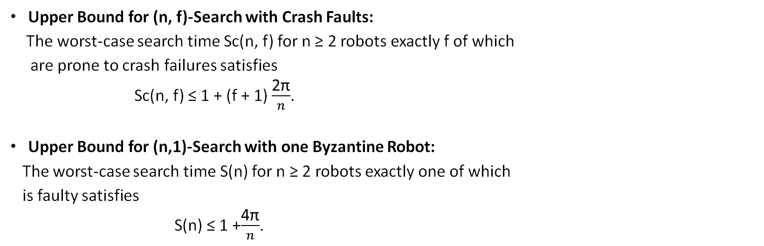
Upper Bound for (n, f)-Search
1 Unknown Exit (K=1)
Upper Bound for (n, f)-Search with Crash Faults:
The worst-case search time Sc(n, f) for n ≥ 2 robots exactly f of which
are prone to crash failures satisfies
Sc(n, f) ≤ 1 + (f + 1) $\frac{\text{2}\text{π}}{n}$.
Upper Bound for (n,1)-Search with one Byzantine Robot:
The worst-case search time S(n) for n ≥ 2 robots exactly one of which
is faulty satisfies
S(n) ≤ 1 +$\frac{\text{4}\text{π}}{n}$.

Slide 15
1 Unknown Exit (K=1)
Example showing (n,f)- Search for Crash Faults and Byzantine faults
Let n=8 ,f=5,k=1
All robots are placed at center of unit circle
Searching in CCW on circumference for hidden exit

Slide 16
1 Unknown Exit (K=1)
a0
a7
a1
a2
a6
a3
a5
a4

Slide 17
1 Unknown Exit (K=1)
a0
a7
a1
a2
a6
a3
a5
a4
Searches in anticlockwise direction

Slide 18
1 Unknown Exit (K=1)
Crash Faulty Robots
a0
a7
Faulty
a1
a6
a2
Faulty
Faulty
a3
a5
Faulty
a4
Faulty
Searches in anticlockwise direction

Slide 19





1 Unknown Exit (K=1)
Crash Faulty Robots
a0
a7
Faulty
a1
a6
a2
Faulty
Faulty
a3
a5
Faulty
a4
Faulty
Searches in anticlockwise direction

Slide 20

1 Unknown Exit (K=1)
Crash Faulty Robots
a0
a7
Faulty
a1
a6
a2
Faulty
Faulty
a3
a5
Faulty
a4
Faulty
Searches in anticlockwise direction

Slide 21

1 Unknown Exit (K=1)
Crash Faulty Robots
a0
a7
Faulty
a1
a6
a2
Faulty
Faulty
a3
a5
Faulty
a4
Faulty
Searches in anticlockwise direction

Slide 22

1 Unknown Exit (K=1)
Crash Faulty Robots
a0
a7
Faulty
a1
a6
a2
Faulty
Faulty
a3
a5
Faulty
a4
Faulty
Searches in anticlockwise direction

Slide 23



1 Unknown Exit (K=1)
Crash Faulty Robots
a0
a7
Faulty
a1
a6
a2
Faulty
Faulty
a3
a5
Faulty
a4
Faulty
Searches in anticlockwise direction

Slide 24

1 Unknown Exit (K=1)
Crash Faulty Robots
a0
Exit
a7
Faulty
a1
a6
a2
Faulty
Faulty
a3
a5
Faulty
a4
Faulty
Searches in anticlockwise direction

Slide 25
1 Unknown Exit (K=1)
Byzantine Faulty Robots
a0
a7
Faulty
a1
a6
a2
Faulty
Faulty
a3
a5
Faulty
a4
Faulty
Searches in anticlockwise direction

Slide 26
1 Unknown Exit (K=1)
Byzantine Faulty Robots
a0
a7
Faulty
a1
a6
a2
Faulty
Exit?
Faulty
a3
a5
Faulty
a4
Faulty
Searches in anticlockwise direction

Slide 27
1 Unknown Exit (K=1)
Byzantine Faulty Robots
a0
a7
Faulty
a1
a6
a2
Faulty
Faulty
Exit?
a3
a5
Faulty
a4
Faulty
Searches in anticlockwise direction

Slide 28
1 Unknown Exit (K=1)
Byzantine Faulty Robots
a0
a7
Faulty
a1
a6
a2
Faulty
Exit?
Faulty
a3
a5
Faulty
a4
Faulty
Searches in anticlockwise direction

Slide 29
1 Unknown Exit (K=1)
Byzantine Faulty Robots
a0
a7
Faulty
a1
a6
a2
Exit?
Faulty
Faulty
a3
a5
Faulty
a4
Faulty
Searches in anticlockwise direction

Slide 30
1 Unknown Exit (K=1)
Byzantine Faulty Robots
a0
a7
Faulty
a1
a6
a2
Exit?
Faulty
Faulty
a3
a5
Faulty
a4
Faulty
Searches in anticlockwise direction

Slide 31
1 Unknown Exit (K=1)
Byzantine Faulty Robots
a0
a7
Faulty
a1
Exit?
a6
a2
Faulty
Faulty
a3
a5
Faulty
a4
Faulty
Searches in anticlockwise direction

Slide 32
1 Unknown Exit (K=1)
Byzantine Faulty Robots
a0
Exit
a7
Faulty
a1
a6
a2
Faulty
Faulty
a3
a5
Faulty
a4
Faulty
Searches in anticlockwise direction

Slide 33
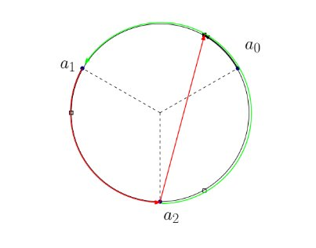
1 Unknown Exit (K=1)
(3, 1)-search with a Byzantine-faulty robot
The worst case search time for 3 robots when one of them is Byzanytine faulty satisfies
S(3)≤4π/3

Slide 34
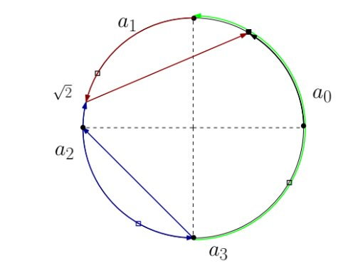
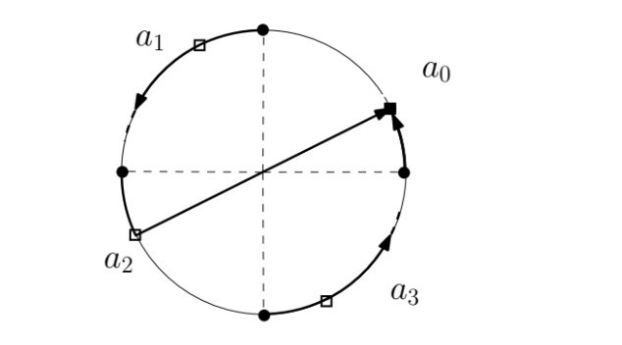
1 Unknown Exit (K=1)
(4, 1)-search with a Byzantine-faulty robot
The search time for 4 robots exactly one of them is faulty satisfies
S(4)≤1+4π

Slide 35
2 Unknown Exits (K=2)
Bounds for (n,f,2)-Search With Crash Faulty Robots
Lower Bound satisfies
T ≥ 1+2π/n
Upper Bound satisfies
T ≤ 1+f.2π/n

Slide 36
2 Unknown Exit (K=2)
Example showing (n,f,k)- Search for Crash Faults
Let n=8 ,f=5,k=2
All robots are placed at center of unit circle
Searching in CCW on circumference for nearest hidden exit

Slide 37
2 Unknown Exits (K=2)
a0
a7
a1
a2
a6
a3
a5
a4

Slide 38
2 Unknown Exits (K=2)
a0
a7
a1
a2
a6
a3
a5
a4
Searches in anticlockwise direction

Slide 39
2 Unknown Exits (K=2)
Crash Faulty Robots
a0
a7
Faulty
a1
a6
a2
Faulty
Faulty
a3
a5
Faulty
a4
Faulty
Searches in anticlockwise direction

Slide 40
2 Unknown Exits (K=2)
Crash Faulty Robots
a0
a7
Faulty
a1
a6
a2
Faulty
Faulty
a3
a5
Faulty
a4
Faulty
Searches in anticlockwise direction

Slide 41
2 Unknown Exits (K=2)
Crash Faulty Robots
a0
a7
Faulty
a1
a6
a2
Faulty
Faulty
a3
a5
Faulty
a4
Faulty
Searches in anticlockwise direction

Slide 42
2 Unknown Exits (K=2)
Crash Faulty Robots
a0
a7
Faulty
a1
a6
a2
Faulty
Faulty
a3
a5
Faulty
a4
Faulty
Searches in anticlockwise direction

Slide 43
2 Unknown Exits (K=2)
Crash Faulty Robots
a0
a7
Faulty
a1
a6
a2
Faulty
Faulty
a3
a5
Faulty
a4
Faulty
Searches in anticlockwise direction

Slide 44

2 Unknown Exits (K=2)
Crash Faulty Robots
a0
a7
Faulty
a1
Exit
a6
a2
Faulty
Faulty
a3
a5
Faulty
a4
Faulty
Searches in anticlockwise direction

Slide 45
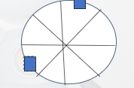



2 Unknown Exits (K=2)
(n,f,k)-Search with crash faults (k=2)
No fault (f=0): T=1+2π/n
One fault (f=1): T=1+4π/n
Two fault (f=2): T=1+4π/n
T=1+4π/n
Not possible
f
Exit
f
T=1+2π/n
T<1+4π/n
f
f
f
f
f
f
Exit

Slide 46
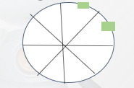


2 Unknown Exits (K=2)
(n,f,k)-Search with crash faults (k=2)
Three fault (f=3): T=1+6π/n​
T=1+(3)2π/n​​
T=1+(2)2π/n​​
T<1+(2)2π/n​​
T=1+2π/n​​
f
f
f
f
f
f
f
f
f
f
f
f
Optimal Search time for the (n,f,k)-Search with crash faults satisfies
T=1+f.2π/n

Slide 47
Similarly, we can check for every cases k=3,4,… and find the optimal algorithm satisfying all criterions.
For K=3: Worst Case Search Time T=1+(f-1)2π/n
And so on.

Slide 48
Results
For Byzantine Faults (n, 1)-search on a circle has a worst-case optimal search completion time of
1 + 4π/n.
(n,f,k) search with crash faults: (n>f+1)
K=0: No exit point so takes infinite time
K=1: Worst Case Search Time T=1+(f+1)2π/n.
K=2: Worst Case Search Time T=1+f.2π/n.
K=3: Worst Case Search Time T=1+(f-1)2π/n.
K=4,5,6,...n-1: Worst Case Search Time T=1+(f+1-k)2π/n.

Slide 49
Conclusion
The optimality for the Byzantine case is surprising, given the scarcity of tight bounds for search on a circle even in the wireless model.
Extending the results to multiple Byzantine-faulty robots or to the evacuation problem are two challenging open problems in the context of circle search.
Extending the results to multiple exits and multiple Byzantine faults are two challenging open problems in the context of circle search.

Slide 50
Future Problem
Investigating the impact of varying robot speeds on search efficiency.
Exploring strategies to handle Byzantine-faulty robots in the search process.
Examining the scalability of the optimal search time bounds for larger robot networks.
Cases of increasing Byzantine robots
Multiple exits case for the Byzantine faults.
Complex case of multiple exits including both types of faults together in a search

Slide 51
Thank You.

